Slide 1

What Factors Drive Click Rate?
Thinkful | Capstone III
October 3, 2022
Cheryl Anderson

Slide 2

Click Rate Analysis
Introduction & Goals
Process
Four Factors that Drive Click Rate
Recommendations
Conclusion

Slide 3

Introduction
Click Rate drives business to your site. But what are the factors that influence a user to click the ad?
Goals
Perform statistical analysis on factors that drive click rate
Determine a Target Market for future advertising

Slide 4
Process
Dataset: https://www.kaggle.com/datasets/tbyrnes/advertising. This dataset has 1000 rows and 10 columns, of which I chose the four factors to investigate in this analysis.
Statistical Analysis will be performed on the relationship of the four factors that influence click rate. We will use correlation and t-test analysis, find a p-value, and deliver recommendations based on the results.
Click rate is documented in the column "Clicked on Ad," which is indicated by 1 if the user clicked on the ad, and 0 if the user did not click on the ad.
Time is measured in minutes.

Slide 5
Four Factors that Drive Click Rate
Daily Time Spent on Site
Age
Area Income
Daily Internet Usage
Hypothesis #1 Null: There is no statistical significance between "Daily Time Spent on Site," and click rate. Alternative: There is a statistical significance between "Daily Time Spent on Site" and click rate.
Hypothesis #2 Null: There is no statistical significance between "Age" and click rate. Alternative: There is a statistical significance between "Age" and click rate.
Hypothesis #3 Null: There is no statistical significance between "Area Income" and click rate. Alternative: There is a statistical significance between "Area Income" and click rate.
Hypothesis #4 Null: There is no statistical significance between "Daily Internet Usage," and click rate. Alternative: There is a statistical significance between “Daily Internet Usage” and click rate.

Slide 6
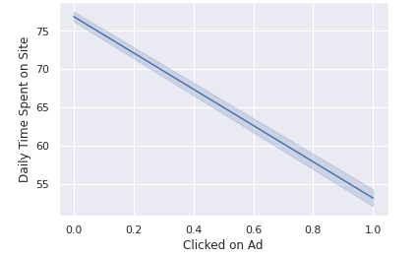
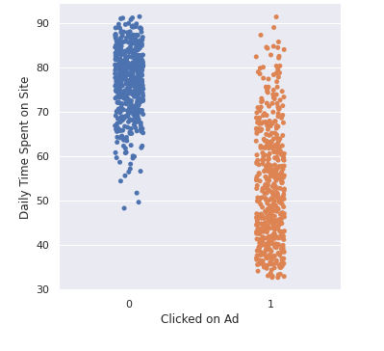
Factor 1: Daily Time Spent on Site
Alternative Hypothesis is correct: After running the t-test, we see that the statistic is a negative number, which indicates there is a negative relationship. The more time spent on the site, the less likely the user is to click the ad. Our p-value is 0, which indicates there is a statistical significance.
Users who spent 35-60 minutes on the site were the most likely to click on the ad.

Slide 7
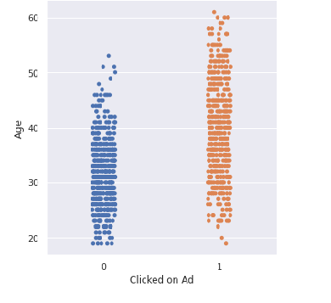
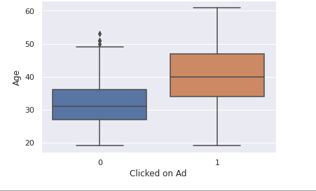
Factor 2: Age
Alternative Hypothesis was correct: Our initial correlation test showed there was a relationship between age and click rate. Further investigation revealed that the average age of users who clicked on the ad was 36, but that users aged 42 held the 75th percentile of users who clicked on the ad.
Users between 35-45 drive the most clicks.

Slide 8
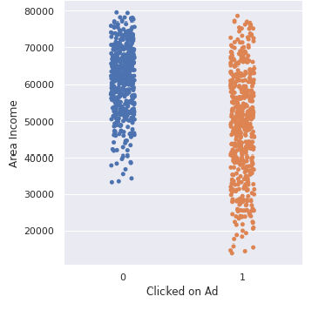
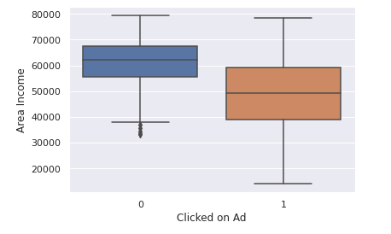
Factor 3: Area Income
Alternative Hypothesis was correct: From our initial statistical analysis, Area Income has a strong correlation to click rate. However, further investigation revealed a negative relationship, in that the higher- income users did not click on the ads as much as the middle-income users. The graphs below demonstrate this relationship:
Users with an income between $39k-$55k per year were most likely to click on the ad.

Slide 9
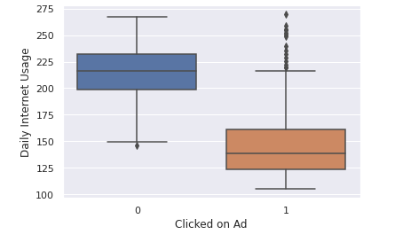
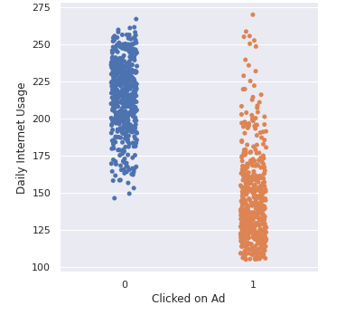
Factor 4: Daily Internet Usage
Alternative Hypothesis was correct: Daily Internet Usage has a strong statistical relationship to click rate. The statistical analysis showed a negative relationship with a p-value of 0. After breaking down the data further, it became clear that the users who spent more time online per day clicked the ad less.
Users who spent an average of 125-165 minutes per day online were most likely to click the ad.

Slide 10

Recommendations
Target Market:
Actions:
Users who spend between 35-60 minutes on the site.
Users who are between the ages of 35-45
Users whose income is between $39k-$55k
Users who spend between 125-165 minutes per day online.
Use the Target Market criteria to guide future advertising campaigns.
Conduct statistical analysis further to determine if there is a relationship with other factors and click rate.
Address any further questions and concerns with proper hypotheses and testing.

Slide 11

Conclusion
The factors that drive click rate are no longer a mystery. With statistical analysis, we can save time and money on future advertising campaigns and maximize profit.
Thank you for your time and please let me know if you have any questions.
Cheryl Anderson

